Slide 1
Gifter

Slide 2
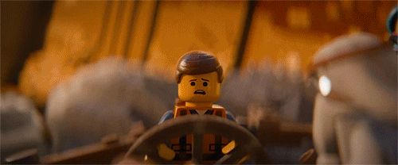
Inspiration

Slide 3

Basic Idea
See what your friends and family actually want

Slide 4

Buy a Gift for a Friend
With a Friend

Slide 5
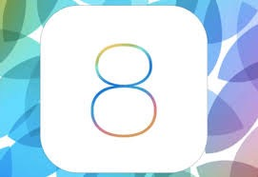
Front End

Slide 6
Back End

Slide 7


Data Storage
vs

Slide 8
Knowledge to Acquire
iOS Development
Experience with writing a RESTful API
New languages

Slide 9
Fin

